Slide 1
Cloud Computing
@thecodealchemist

Slide 2

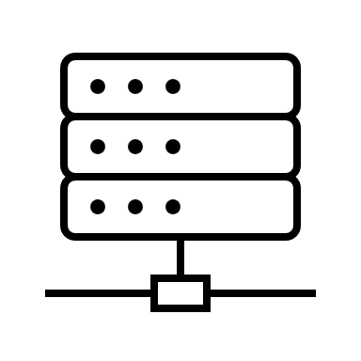



Traditional Computing
Upgrade
Upgrade

Slide 3
Traditional Computing Contd..
Company is responsible for
Data centres
Security including staff and security personnels
Electricity
Hardware
Software, updates, patches
Everything to keep things up and running

Slide 4

What’s the problem?
Slow on-boarding
Planning in advance
Time to market
Cost

Slide 5
Cloud Computing
Delivery of computing services over the internet
Services e.g.
Virtual Machines
Containers
Databases
Networking
Storage

Slide 6
Key Characteristics
Computing resources on-demand
Resource Pooling
Everything-as-a-Service
Pay as you go model

Slide 7
Service Types
Infrastructure as a Service (IaaS)
Platform as a Service (PaaS)
Software as a Service (Saas)

Slide 8
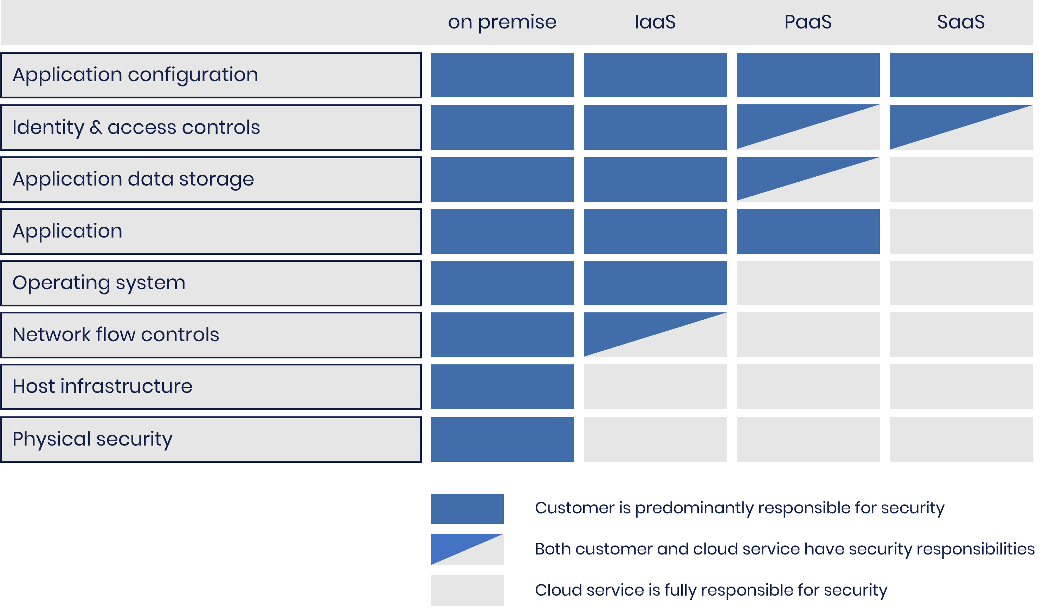
Shared Responsibility Model

Slide 9
Cloud Models
Private Cloud
Public Cloud
Hybrid Cloud
Multi Cloud

Slide 10
Benefits
High availability
Scaling
Reliability
Monitoring
Performance/Good user experience
Cost effective

